Slide 1
Basics in Deep Q-Learning

Slide 2
Contents
Concepts of Deep Q-Learning
A Practical Example

Slide 3
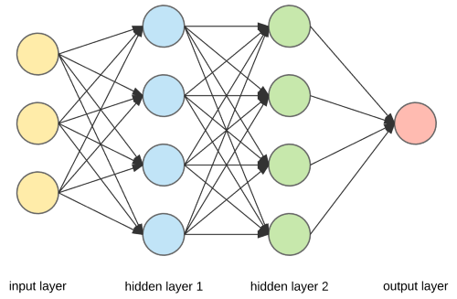
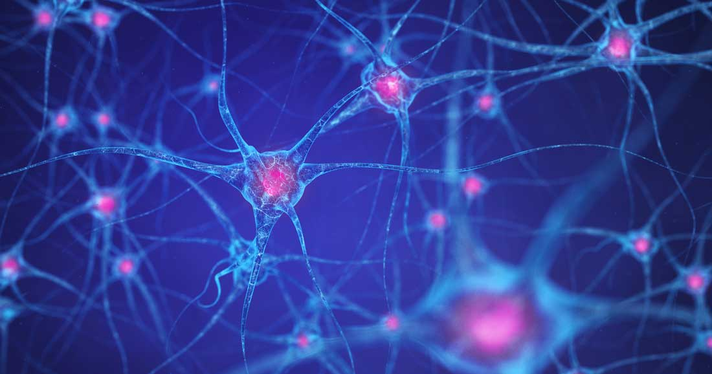
Deep learning in a nutshell
Emulates
Neural Network
Human brain neurons
2, 3

Slide 4
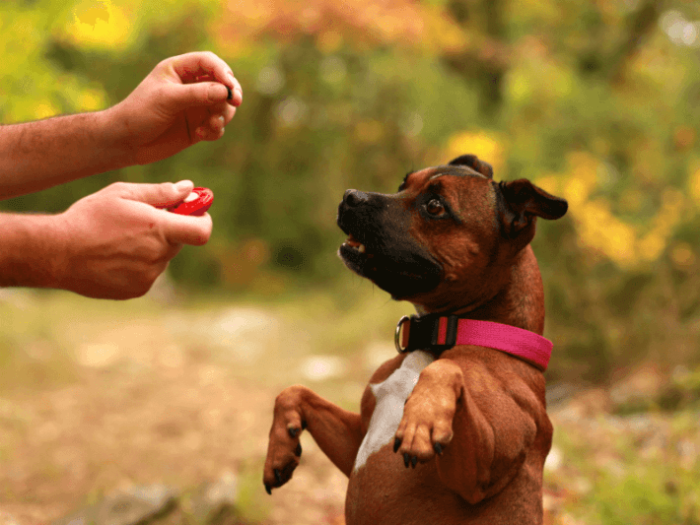
Deep Q-learning
4

Slide 5
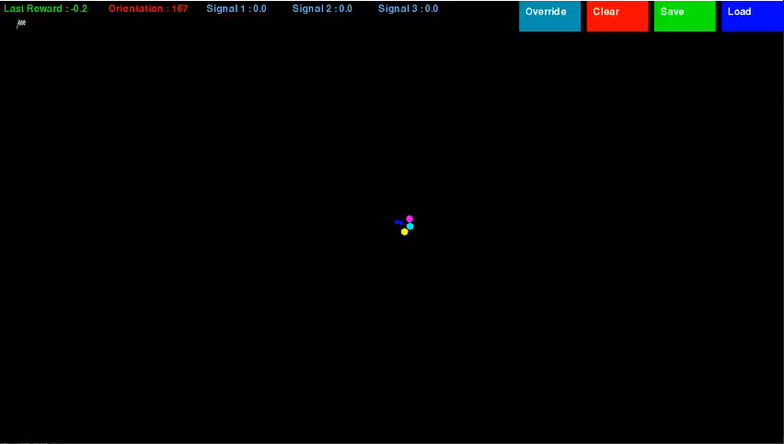

ACTION!
167 Degrees

Slide 6
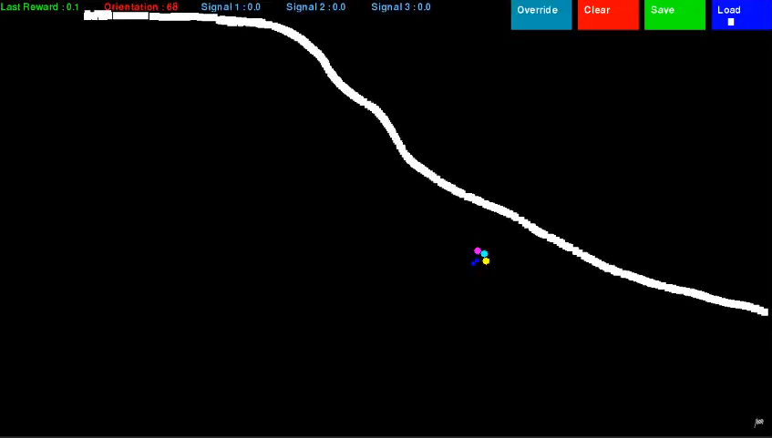
WITH experience

Slide 7
Reference
1) https://www.edureka.co/blog/ai-vs-machine-learning-vs-deep-learning/
2) https://www.dana.org/article/how-does-the-brain-work/
3) https://towardsdatascience.com/everything-you-need-to-know-about-neural-networks-and-backpropagation-machine-learning-made-easy-e5285bc2be3a
4) https://www.quickanddirtytips.com/pets/dog-behavior/how-does-clicker-training-work
5) https://en.wikipedia.org/wiki/Artificial_intelligence
6) https://hackernoon.com/deep-learning-vs-machine-learning-a-simple-explanation-47405b3eef08

Slide 8
conclusion

Slide 9
THANK YOU

Slide 10
Questions?

